Slide 1
Polis White paper
Polis White Paper Version v3.0
by The Polis Development Team
Created February 11, 2018
Updated v1.1 March 1, 2018
Updated v2.0 April 22, 2018
Updated v3.0 November 1, 2018

Slide 2
Introduction

Slide 3
Polis is a cryptocurrency designed for global community.
Polis uses decentralized governance and a system of democratic financing to generate global impact.
Most cryptocurrencies are controlled entirely by a small group of developers and insiders. Instead, Polis flips this model upside-down by transferring democratic power to the Polis community.
Community members are given a vote through Masternode ownership.
These votes determine which community proposals pass or fail. Anyone can create a community proposal about anything: a charitable donation, a community event, a direct change to Polis’s code base, etc.
These proposals are executed and funded by The Polis Foundation.

Slide 4
Polis connects digital communities and marginalized countries in developing areas.
Supported by a passionate online community and experienced developers, the Polis mission is global impact through consensus-backed philanthropy and humanitarian efforts.
Polis will never have an ICO because Polis is available for use by all people. Development is funded by a low pre-mine of 1% and ownership of 1% of Masternodes.
This ensures that 99% of Polis is in the hands of the community. The community makes all future project financing decisions with decentralized governance and voting.

Slide 5
Polis is Greek for community. Our motto is Polis Empowers People.
People thrive when they can connect and trade freely.
Polis uses decentralized advanced blockchain technology to solve important problems for our global community.

Slide 6
Bitcoin Summarized

Slide 7
Peer-to-Peer Payment Network
Polis will never have an ICO because Polis is available for use by all people. This system allows for greater financial autonomy, requires no reliance on a central authority and grants true control over one’s financial assets.
Since the launch of Bitcoin, many alternative options and currencies have emerged. In 2015, Evan Duffield published the Dash Whitepaper, proposing a payment system that improved on Bitcoin by adding a layered, two-tier incentivized Masternode network and various transaction upgrades including InstantSend.

Slide 8
The Blockchain
Bitcoin’s blockchain technology creates blocks by combining chronological transactions.
These blocks are confirmed by a network of nodes. Each of these blocks contains the necessary information to build on prior blocks through the consensus of the workers.
However, Bitcoin does not reward node owners and the number of Bitcoin nodes has been dwindling, causing the network to be slow, unstable and expensive.

Slide 9
Lack of Community Governance
Another issue with Bitcoin is the absence of community involvement in the future of the currency.
Since Bitcoin’s inception, Satoshi Nakamoto has remained anonymous. Satoshi later delegated control of Bitcoin to early community members and today Bitcoin is controlled by a fractured set of developers.
There is general unrest regarding Bitcoin consensus, with multiple forks including Bitcoin Cash, Bitcoin Gold and others emerging as a result of the community’s discontent with the lack of democratic decision making.

Slide 10
Various debates have raged over the past few years over block size increases, SegWit, lightning network and more. Bitcoin lacks an effective way of allowing community members to vote on collective direction, which results in a fractured group unable to reach common consensus.

Slide 11
Comparing Polis

Slide 12
Solving Problems
Polis solves the two major flaws of Bitcoin:
Lack of node incentivization system, resulting in fewer nodes than the network needs to be fast and stable.
Lack of community governance, resulting in forks, a fractured community and a general absence of direction.

Slide 13
Implementing Solutions
Polis adds many benefits that Bitcoin lacks:
1. Powerful Masternode network adds a second tier of computing decentralization. This tier can perform any mathematical or financial task that the community implements.
Currently, the Masternode network adds two features:
InstantSend: perform instant transactions that are irreversible and permanent.
Governance: vote for proposals and perform the superblock transaction.

Slide 14
2. Decentralized governance, allowing community members to participate in the future of Polis. Concepts that Bitcoin struggled with, such as block size increases, can be solved by the Polis community by simply voting on a proposed change.
3. Treasury proposals can further the Polis mission by funding charitable donations, community assistance programs, disaster relief funds or any idea proposed by the commun

Slide 15
Polis Explained

Slide 16
The Polis Development Team and Mission
In 2017, a global group of entrepreneurs began collaborating on idea that a useful, community-controlled charitable cryptocurrency would change the world. Polis was launched in December 2017.

Slide 17
The Polis Development Team has multidisciplinary skill sets that synergize for the benefit of the Polis community. The team’s focus is generating value for all Polis owners, carrying out the will of the community and implementing continual upgrades in the protocol.

Slide 18
The Executive team includes:
Cronos: Core Developer Manager and Developer Coordinator
Ares: Strategic Planning and Project Leader
Poseidon: Marketing, Public Relations and Regulatory Compliance
Apollo: Financial Coordinator
To learn more about each member of the team, please see the Team Members section.

Slide 19
The Polis vision has continued to evolve as our network expanded to over 2,500 Masternodes. In addition to working as a bridge between digital currencies and local goods and services, it was proposed that Polis could become a self-governing system of directing financial resources to communities in need. To read more about the mission and vision of the Polis team, see the Polis Manifesto.

Slide 20
The Polis Community
Eight months after launch, the Polis community grew to thousands of members with over 2,500 active Masternodes.
This group has proven to be an extremely collaborative community of enthusiasts, humanitarians and people from all walks of life.
The decentralized nature of Polis encourages this type of collaborative community by allowing for democratic governance with the common goal of achieving substantial change in our world.
Polis has fostered a creative environment that welcomes and values the opinions, contributions and ideas of all community members, who are encouraged to speak their minds about the future direction of Polis.

Slide 21
Community members with the skills to carry out larger projects for Polis are empowered and encouraged by the development team to contribute as they see fit.
Polis is a collaborative value-added platform constantly being evolved, developed and directed by the community and talented development team. The political efficacy of each Polis community member exponentiates the impact Polis can have on the world.

Slide 22
Reward Calculation
Proof-of-Stake and Masternodes are all ways that various cryptocurrencies reward workers. These reward systems contribute to the creation and confirmation of the Blockchain and each new block distributes the reward among those who perform jobs.

Slide 23
The Polis block reward is split such that 72% of rewards are allocated to Masternodes, 18% of rewards are allocated to miners and 10% are allocated to a community-governed Treasury Fund. Polis includes a unique lucky block system called Lucky Proof-of-Work. This system rewards both miners and Masternodes owners who find a specific block, introducing an element of luck and excitement to the Polis community.

Slide 24
Reward Calculation
The Polis code base dictates that masternode rewards fluctuate based on the current number of masternodes. To calculate daily masternode payouts, one can use the following formula:
(n/t) * r * b * .72
n = number of masternodes owned
t = total active masternodes
r = current block reward
b = blocks per day

Slide 25
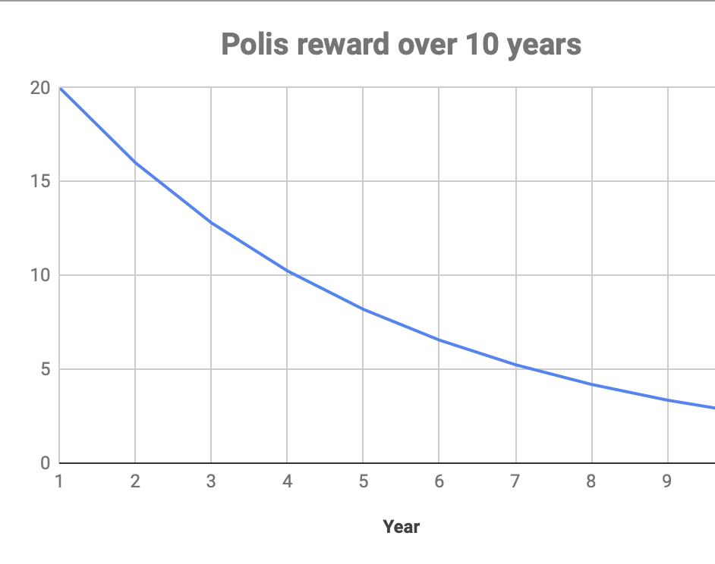
Block Reward Chart
The block rewards will be reduced by 80% every 262800 blocks (365 days, approx).

Slide 26
Polis Marketplace
Polis is equipped to be used as a fully-fledged instant and fungible currency, ready for widespread real-world use.
To encourage rapid proliferation of Polis adoption, the Polis Development Team plans to launch the Polis Marketplace.
By allowing anyone to trade Polis directly for goods and services, the community can achieve several goals: foster a healthy Polis economy, increase decentralization of Polis distribution by allowing anyone to trade goods or services for Polis instead of needing to exchange fiat, and grow the network by increasing transaction throughput.

Slide 27
The Polis Foundation
The Polis Development Team is working to establish The Polis Foundation, a registered non-profit legal entity dedicated to carrying out the philanthropic vision of the Polis community. As the decentralized governance system approves proposals, The Polis Foundation is responsible for carrying out these proposals using the Treasury Fund.

Slide 28
This legal entity is fully compliant with transparency requirements for non-profit organizations and is fully auditable by any Polis community member.
The Polis Foundation will establish relationships with charities, communities, social movements and crisis organizations to facilitate the implementation of community proposals in a swift, professional and reliable manner.

Slide 29
A quick start distribution
A quick start distribution incentivized early adopters and miners to help establish Polis. The initial block reward is 20 Polis. To encourage healthy rapid adoption, block reward remains fixed at 20 Polis for four years. Starting in the fifth year, the block reward is reduced to 2 until after the tenth year, upon which time the reward is obtained entirely from transaction fees.

Slide 30
Proof of Stake

Slide 31
From its beginning in December 2017 and until October 25th, 2018 the consensus mechanism utilized a Proof of Work (PoW) consensus, which suffered alterations and algorithm changes for block difficulty throughout its history.
As of October 25th, the blockchain will move to a Proof of Stake (PoS) consensus. The Polis PoS implementation is based of XSN StakeNet’s which based on Peercoin’s.

Slide 32
Proof of Stake has been proven to be friendlier block validation technology than its PoW counterpart[missing reference] and makes every Polis holder a part of the block validation process and thus keeping the integrity of the blockchain.
We believe this consensus change aligns with the Polis value of handling the power and responsibility of Polis to its community.

Slide 33
Staking
Requisites for Staking
Having an unencrypted wallet (at least unlocked during staking)
The wallet should be synced with the Governance System (Masternodes & Masternode Payments)
Having stakeable coins
All coins having an age greater than two minutes (min coinage) are considered stakeable.

Slide 34
Staking Process
The staking process implies that there is value being gambled on a risky venture.
In a PoS consensus, this means that the user needs to stake coins in hopes of getting chosen to validate a block.
A portion of the user’s staking balance is selected, the greater the stake the bigger the chance of getting chosen.
Then a new block hash is created using the block timestamp, a hash of the staking inputs and a kernel modifier to add entropy. This process is repeated until a hash-target is met and thus, a block is validated.
From the moment a stake amount is used to validate a block, it will remain locked until said block is validated, as the block will contain the returned stake input and reward.

Slide 35
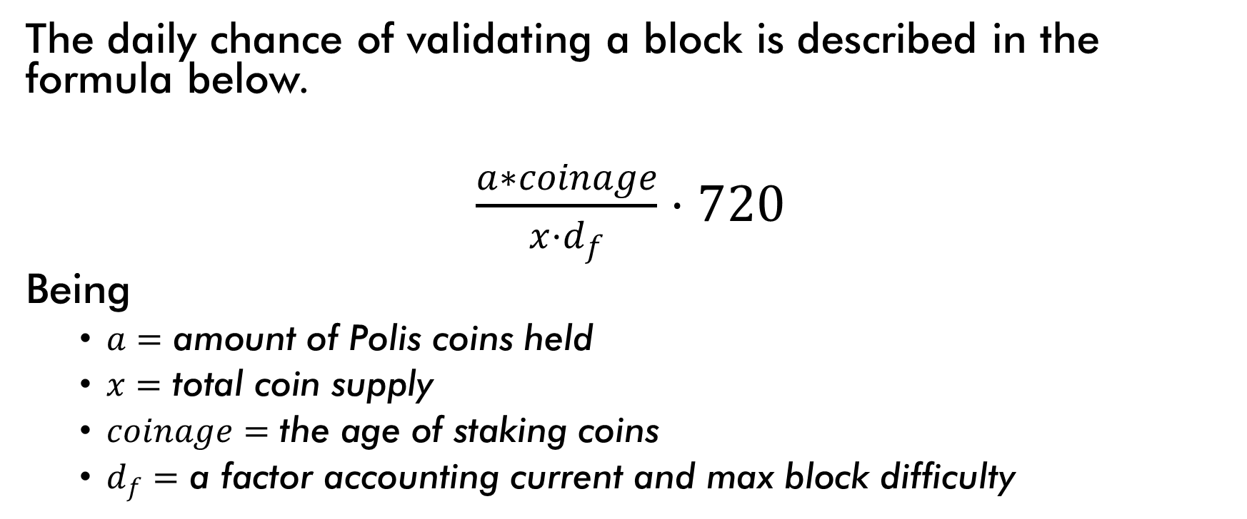
Block Validating & Masternode Chance
The daily chance of validating a block is described in the formula below.
$\frac{a∗coinage}{x⋅d_{f}}⋅720$
Being
$a=\text{amount} \text{of} \text{Polis} \text{coins} \text{held}$
$x=\text{total} \text{coin} \text{supply}$
$coinage=\text{the} \text{age} \text{of} \text{staking} \text{coins}$
$d_{f}=\text{a} \text{factor} \text{accounting} \text{current} \text{and} \text{max} \text{block} \text{difficulty}$

Slide 36
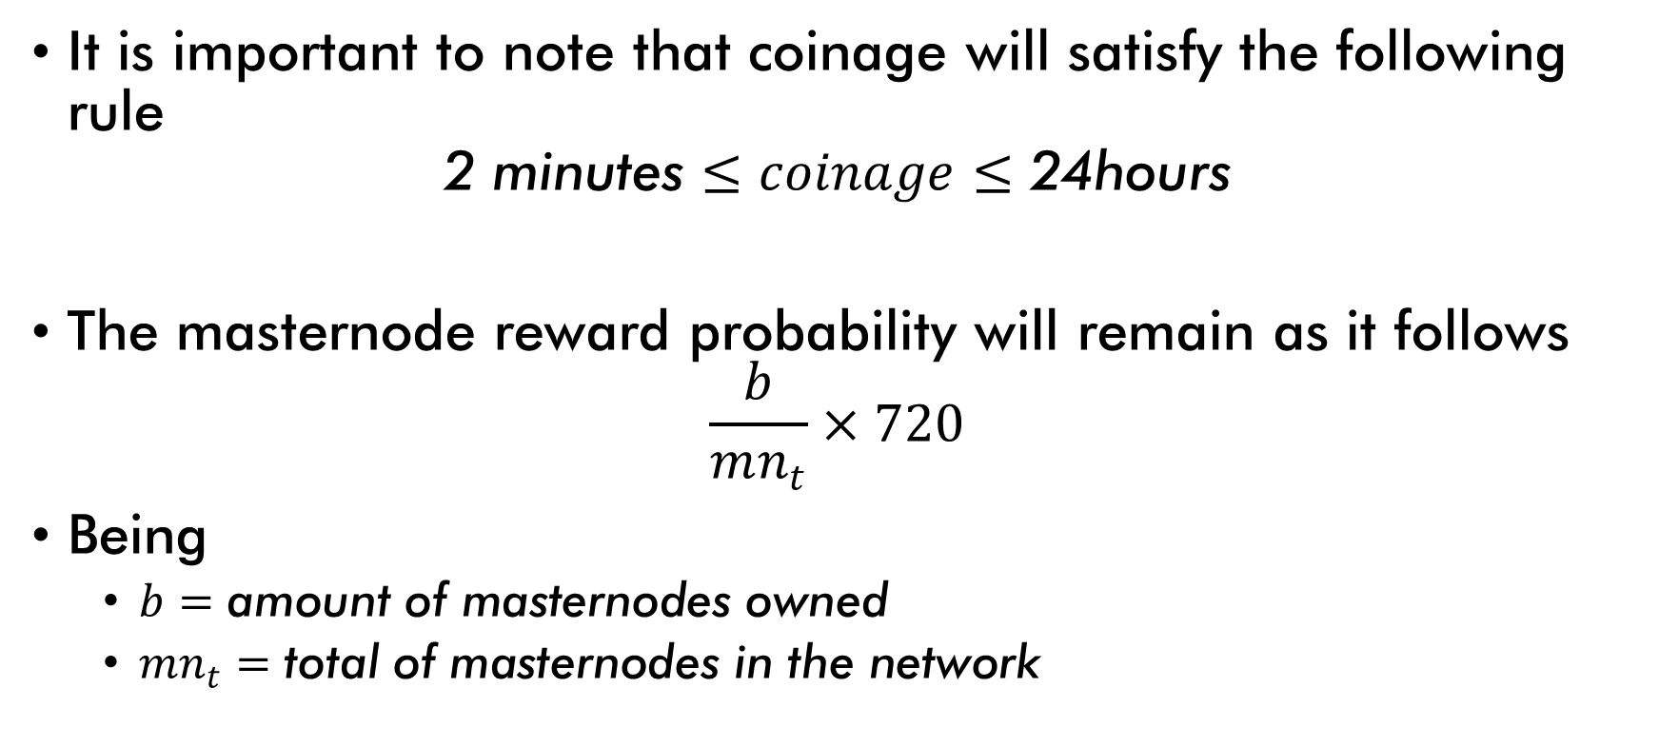
It is important to note that coinage will satisfy the following rule
$$\text{2 }\text{minutes}≤coinage≤\text{24}\text{hours}$$
The masternode reward probability will remain as it follows
$$\frac{b}{mn_{t}}×720$$
Being
$b=\text{amount} \text{of} \text{masternodes} \text{owned}$
$mn_{t}=\text{total} \text{of} \text{masternodes} \text{in} \text{the} \text{network}$

Slide 37
Polis Specifications
Specifications | Value
Ticker | POLIS
Algorithm | X11
RPC Port | 21427
P2P Port | 24126
Testnet RPC Port | 24131
Testnet P2P Port | 24130
Difficulty Algorithm | PoSWorkRequired
Block Size | 2 MB
Block Time | 120 seconds
Masternode Confirmation | 15 blocks
Masternode Collateral | 1000 POLIS
Governance Fee | 5 POLIS
Governance Minimum Quorum | 10 votes

Slide 38
Cryptocurrency for a Better World

Slide 39
In under a decade, cryptocurrencies have revolutionized global finances.
Every day, more people understand the change and benefits cryptocurrencies bring to our world.
Cryptocurrency is inherently a morally-neutral technology.
By aligning incentives in the Polis protocol, the neutrally moral nature of cryptocurrencies can be transformed into a positive and powerful force of change in our world.

Slide 40
Instead of debating code changes, as is common with Bitcoin, Polis can quickly implement changes and then go on to debate more important issues, like how to fund disease prevention programs, how to help victims of a natural disaster or any other need that appears in the world.
Polis is a digital community running a digital currency. Polis uses hive-mind collaboration to understand the world’s needs and to respond accordingly.

Slide 41
Polis integrates into the real-world by allowing users freedom to move between digital and fiat currencies, giving people full autonomy over their financial futures.
The Polis Marketplace establishes a thriving exchange of goods and services, promoting the mission of Polis and increasing adoption. Lastly, The Polis Foundation implements community governance proposals to allow completely democratic control over not just the direction of Polis, but also the specific impacts Polis has on our world.

Slide 42
PolisPay

Slide 43
The Polis Development Team is proud to announce the release of PolisPay Card, a payment card solution allowing anyone to spend Polis, Bitcoin and Dash at over 30 million merchants worldwide.
Working in collaboration with other communities, the Polis Development Team has established formal partnerships with Gobyte, Monoeci and ColossusXT.

Slide 44
These coins will be officially supported on the PolisPay platform and will additionally allow for conversion into fiat. These partnerships have been meticulously selected based on their impressive growth, technical development and community involvement.
The PolisPay Card is being aggressively developed and collaboration with the developers of GBX, XMCC and COLX enables valuable cross-compatibility.

Slide 45
Additionally, The Polis Development Team has hired an experienced credit card merchant service provider for the physical release of PolisPay Cards.
Available globally in Q3 2018 for 25 USD, PolisPay Cards offer convenience and reliability with multiple currency options.

Slide 46
Several outcomes are foreseen from the release of PolisPay:
Greatly increased liquidity due to increased market throughput
Real-world use-case for Polis creating rising economic demand
Powerful word-of-mouth marketing from using cryptocurrencies in daily life
Industry recognition of Polis on the forefront of cutting-edge development
Easy conversion from Polis into fiat and vise versa

Slide 47
Our provider of the cards is CACAO, a paycard solutions company.
Development and distribution of physical payment cards is a sizable undertaking. The Executive Team has assessed the feasibility of a global launch and have taken proper actions, including establishing partnerships across multiple industries, to ensure PolisPay is a success.

Slide 48
The community will be heavily involved in the design, testing and vision of PolisPay. The first real-world Polis transactions mark a powerful milestone. PolisPay marks a positively significant shift in the development and future of Polis. Therefore, all published media has been updated accordingly.

Slide 49
Aknowledgments

Slide 50
This project would not be possible without the previous work of the Bitcoin and Dash development teams. We appreciate their efforts greatly.
We are excited to belong to an open source community and appreciate the opportunity to contribute to this growing technological field.
In addition, we thank the passionate members of the Polis community who have grown this project and participated actively in the evolution of Polis.

Slide 51
Legal

Slide 52
Cryptocurrency investments are inherently high risk. Before using any cryptocurrency, it is important to consider the nature, complexity and risk.
Do not invest more than you can afford to lose. It is important not to use coins without taking into account the possible loss, since the type of change in these currencies is highly volatile and the Polis team is unable to regulate market-defined prices.
We strongly suggest seeking advice from your own financial, investment, tax, or legal adviser.
The Polis Development Team will always act in good faith and is not liable for the use of Polis by other community members, persons or institutions.

